Slide 1

Hidden Markov Model
Dr. Linrui Zhang
University of Central Missouri

Slide 2
Outline
Markov Chains
Hidden Markov Model
Viterbi Algorithm

Slide 3

Markov Chains
The HMM is based on augmenting the Markov chain. A Markov chain is a model that tells us something about the probabilities of sequences of random variables, states, each of which can take on values from some set.
A Markov chain makes a very strong assumption that if we want to predict the future in the sequence, all that matters is the current state. The states before the current state have no impact on the future except via the current state.

Slide 4
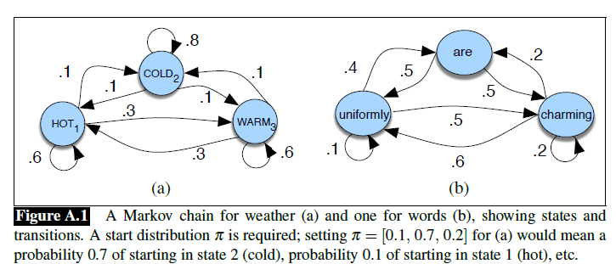
Markov Chains

Slide 5
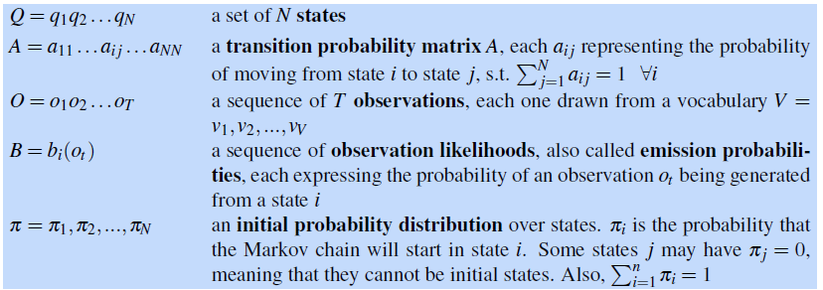
Hidden Markov Model
A hidden Markov Model (HMM) allows us to talk about both observed events and hidden events that we think of as causal factors in our probabilistic model. An HMM is specified by the following components.

Slide 6
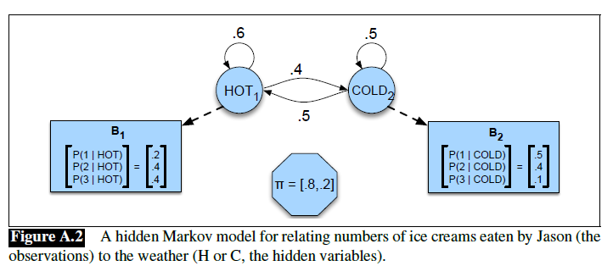
Hidden Markov Model
Input: Jason eat 3, 1, 3 ice creams in the past 3 days.
Output: What is the weather like in the past 3 days?
Q: States A: transition probability matrix A O: observation B: observation likelihood π: initial probability distribution

Slide 7
The Viterbi Algorithm
Decoding: Given as input an HMM λ = (A, B) and a sequence of observations O = o₁, o₂, …, o_{T}, find the most probable sequence of states Q = q₁q₂q₃…q_{T}.
The most common decoding algorithms for HMMs is the Viterbi algorithm.

Slide 8
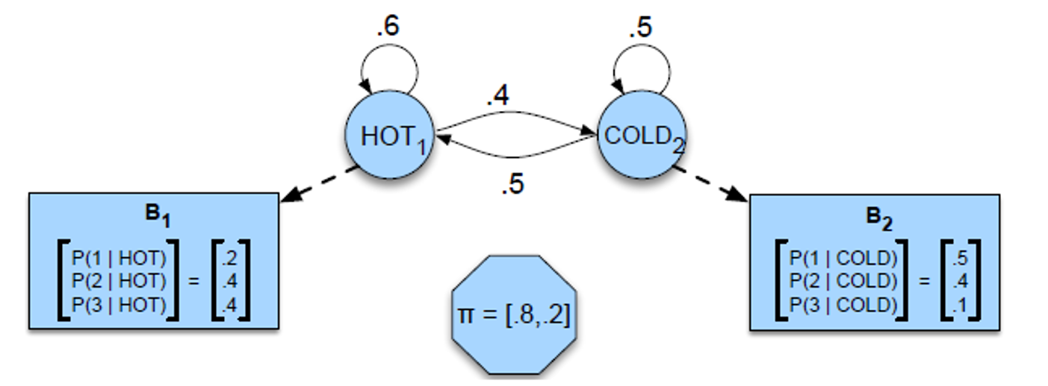
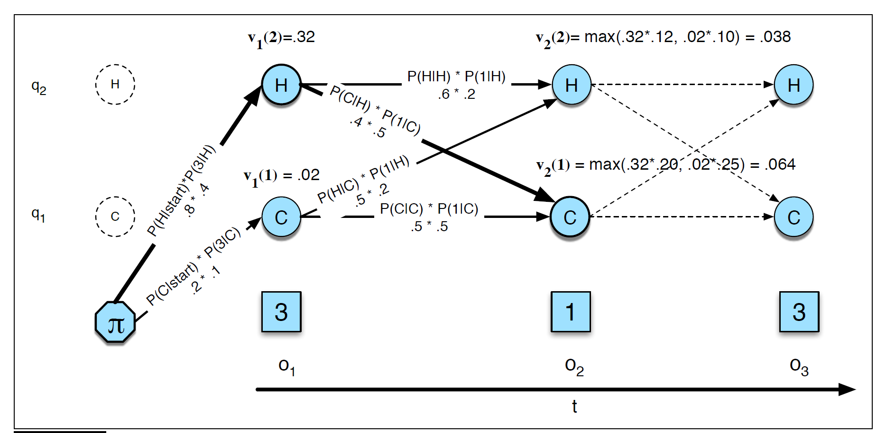
Viterbi algorithm

Slide 9
Viterbi algorithm
Now try this example by yourself!

Slide 10
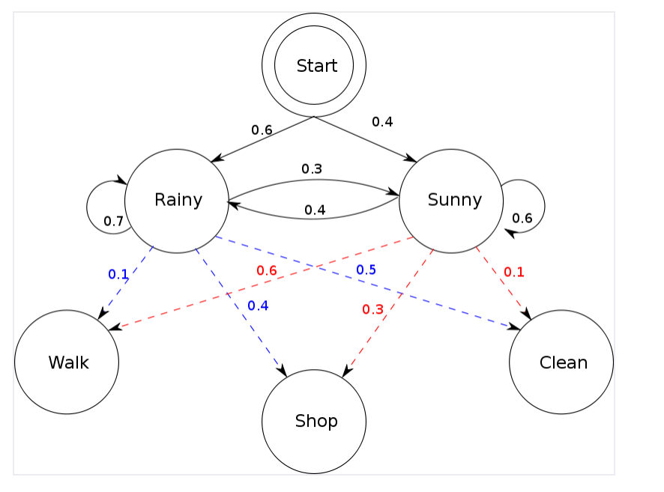
Example 2
If for three days, Bob is Walk, Shop, and Clean, what was the weather? Using the Viterbi algorithm.

